Slide 1

Hotel Reservation Analysis using SQL
- By Jagruti Yewale

Slide 2

Project overview
A hotel reservation analysis project using SQL involve several aspects, including data retrieval, manipulation, and analysis from a database containing hotel reservation information.
It involves exploring , cleaning and analyzing reservation data to derive insights.
This includes querying data to calculate revenue, identify booking trends, and understand customer behaviour. Our goal is to extract insights of customer and factors including hotel functionalities.

Slide 3

Objective
SQL is essential for tasks such as querying data, creating and modifying database structures, and performing various operations on data, including filtering, sorting, and aggregating.
The objective of a hotel reservation analysis project using SQL is to extract valuable insights from reservation data. This includes understanding booking patterns, identifying revenue sources, optimizing pricing strategies, and enhancing customer experience.

Slide 4
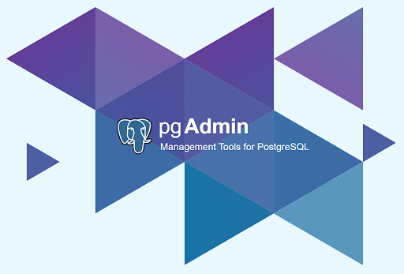
Tools used in Project
PgAdmin is an open-source graphical user interface (GUI) tool used for managing PostgreSQL databases.
It provides an intuitive interface for developers and database administrators to interact with PostgreSQL databases, allowing them to perform tasks such as creating and managing databases, executing SQL queries, designing database schemas, and monitoring database performance.

Slide 5
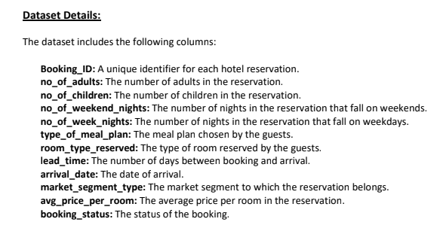
About Dataset

Slide 6
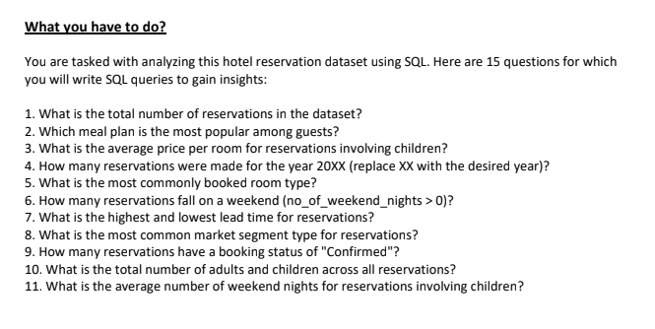
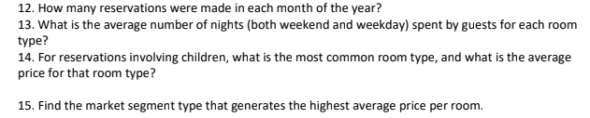
Task

Slide 7
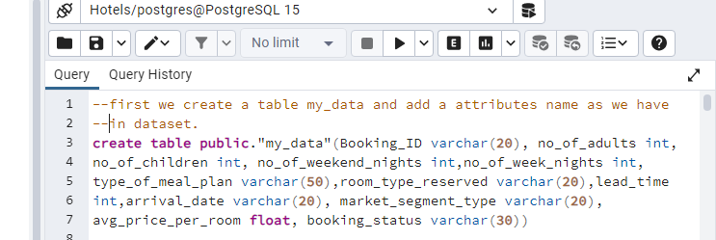
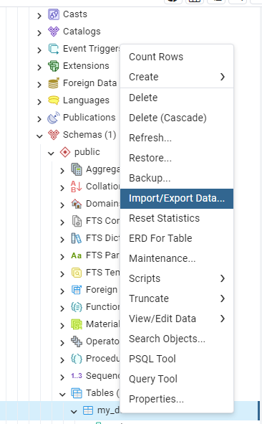
Import Dataset

Slide 8
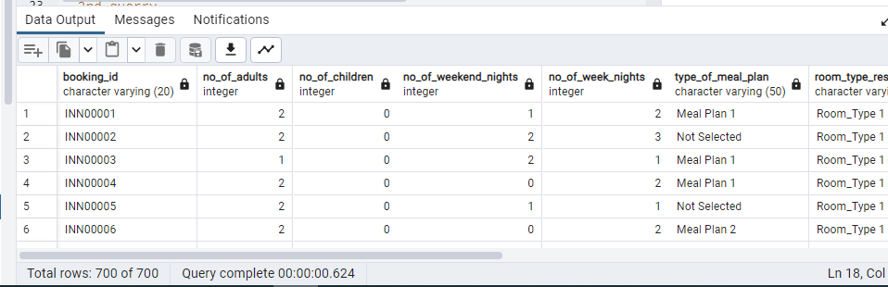
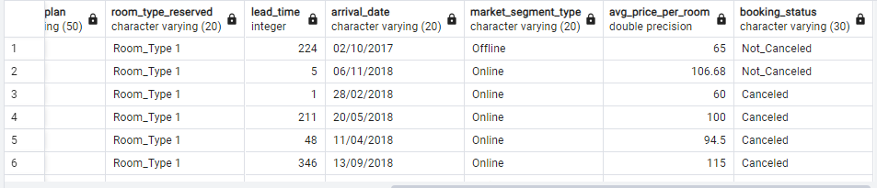
Loading the Dataset

Slide 9

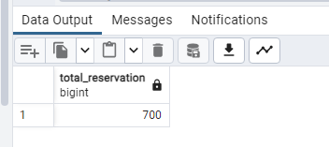
Coming on Queries-
1.What is the total number of reservations in the dataset?
Code-
Output-
Insights-
There are total 700 reservation in the datasets because there are total 700 rows is presents in dataset.

Slide 10
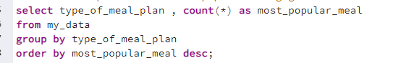

2. Which meal plan is the most popular among guests?
Code-
Output-
Insights-
There Meal Plan 1 is the most popular meal ordered by customer in a hotel.

Slide 11
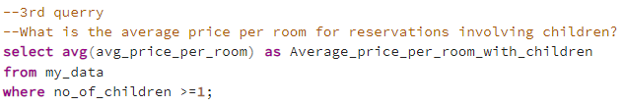
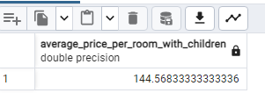
3. What is the average price per room for reservations involving children?
Code-
Output-
Insights-
There are 144.568333 average price per rooms for reservation including children.

Slide 12

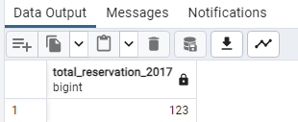
4. How many reservations were made for the year 20XX (replace XX with the desired year)?
Code-
Output-
Insights-
There are 123 Total Reservation in the hotel in 2017 year.

Slide 13
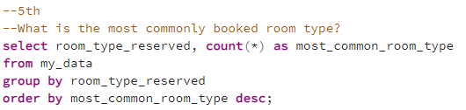
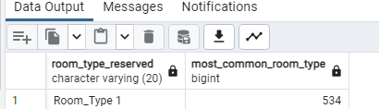
5. What is the most commonly booked room type?
Code-
Output-
Insights-
There are Room_Type 1 is the most popular for booking by the customer in the hotel.

Slide 14

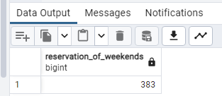
6. How many reservations fall on a weekend (no_of_weekend_nights > 0)?
Code-
Output-
Insights-
There are 383 reservation fall on Weekends.

Slide 15

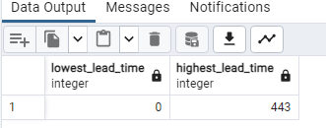
7.What is the highest and lowest lead time for reservations?
Code-
Output-
Insights-
There are 0 lowest lead time and 443 highest lead time for reservation in the hotel.

Slide 16
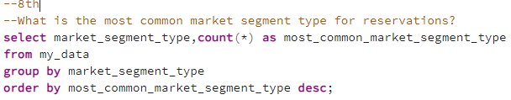
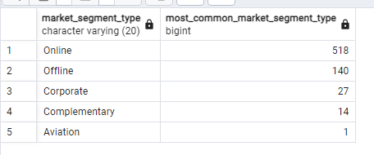
8. What is the most common market segment type for reservations?
Code-
Output-
Insights-
Online is the most market segment type for reservations.

Slide 17


9. How many reservations have a booking status of "Confirmed"?
Code-
Output-
Insights-
The reservations have a booking status of "Confirmed“ is 493.

Slide 18

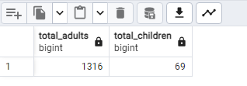
10. What is the total number of adults and children across all reservations?
Code-
Output-
Insights-
the total number of adults is 1316 and children is 69 across all reservations.

Slide 19

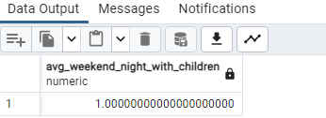
11. What is the average number of weekend nights for reservations involving children?
Code-
Output-
Insights-
1.0000 is the average number of weekend nights for reservations involving children.

Slide 20

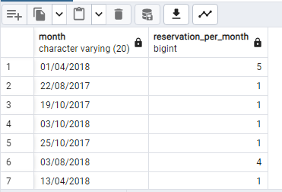
12. How many reservations were made in each month of the year?
Code-
Output-
Insights-
There found different reservation were ,made in each month of the year.

Slide 21

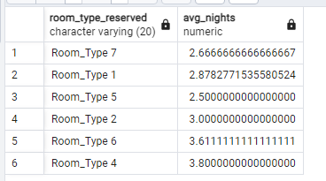
13. What is the average number of nights (both weekend and weekday) spent by guests for each room type?
Code-
Output-
Insights-
There are different averages found by grouping the room_type_reservered.

Slide 22

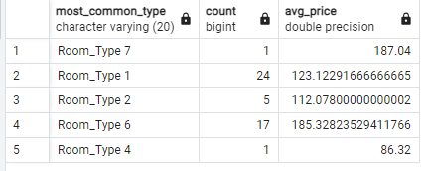
14. For reservations involving children, what is the most common room type, and what is the average price for that room type?
Code-
Output-
Insights-
The most common room type is Room_Type_7 includings with 187.04 average price.

Slide 23

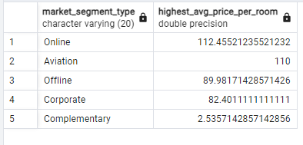
15. Find the market segment type that generates the highest average price per room.
Code-
Output-
Insights-
The highest average price per room is 112.455212 for online segment type.

Slide 24
Some Another Insights of Datasets-
Analyzing hotel reservation data using SQL can provide several meaningful insights for hotel management and marketing teams :-
Booking Trends: SQL queries can reveal booking trends such as peak booking times, popular room types, and booking lead times. Understanding these trends can help hotels optimize pricing strategies and manage inventory effectively.
Customer Segmentation: By analyzing reservation data, hotels can segment their customers based on demographics, booking behavior, and preferences. This segmentation enables targeted marketing campaigns and personalized services tailored to different customer groups.
Cancellation Patterns: Analyzing cancellation patterns can help hotels understand the reasons behind cancellations and identify strategies to minimize cancellations, such as offering flexible cancellation policies or targeted promotions to incentivize guests to keep their bookings.
Channel Performance: Hotels can analyze reservation data to evaluate the performance of different booking channels, including direct bookings, online travel agencies (OTAs), and corporate bookings. Understanding channel performance helps hotels allocate marketing resources effectively and optimize distribution strategies.

Slide 25
Forecasting Demand: By analyzing historical reservation data, hotels can forecast future demand for rooms and adjust pricing and inventory strategies accordingly. This proactive approach helps hotels maximize revenue and avoid overbooking or underbooking situations.
Guest Satisfaction Analysis: SQL queries can join reservation data with guest feedback data to analyze guest satisfaction levels based on factors such as room type, booking experience, and amenities. This analysis helps hotels identify areas for improvement and enhance the overall guest experience.
Seasonal Patterns: Analyzing reservation data over different seasons can reveal seasonal booking patterns and trends. This insight enables hotels to adjust their marketing efforts, pricing strategies, and operational resources to meet the fluctuating demand throughout the year.
By leveraging SQL for hotel reservation analysis, hotels can gain valuable insights into their operations, guest behavior, and market dynamics, enabling them to make data-driven decisions to improve performance and drive profitability.

Slide 26


